Slide 1
Sogrape_Hackathon
Online Wine Price Harvesting Challenge

Slide 2
Problem at hands:
Tracking wine prices from different online stores in an effective manner
Approach:
Brainstorming all the possible scenarios for the final product
Choosing adequate tools for our project’s needs
Organizing the team by tasks
Web scraping
Database
Dashboard

Slide 3
Project Advantages:
User-friendly dashboard that can track all the desired wines
Simple and organized database (MySQL)
Evolution and history of wine prices
Strong base capable of adding features

Slide 4
Future implementations:
User login for data security
Management of user permissions
Improvement of the web scraping
Development of the graphical interface
Wine price changes notifications
Back office configuration for new scrapings
Adaptability to scale for further demands

Slide 5
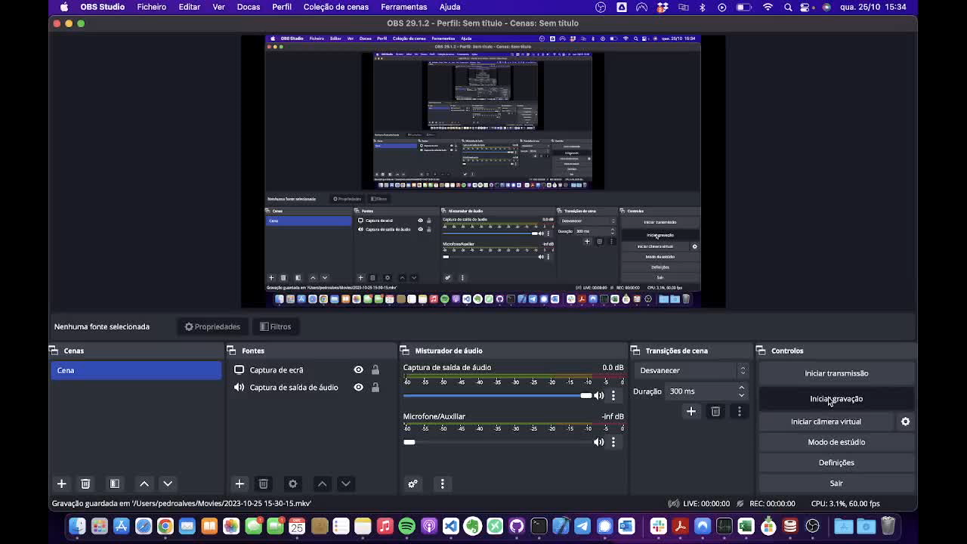
Web Scraping

Slide 6
Database
Prices:
price_id 🔑
price_value
discount
currency
timestamp
product_url
wine_id 🗝️
store_id 🗝️
Wines:
wine_id 🔑
wine_name
harvest_year
capacity
location
EAN
wine_image
Stores:
store_id 🔑
store_name
store_url
🔑: Primary key 🗝️: Foreign key

Slide 7
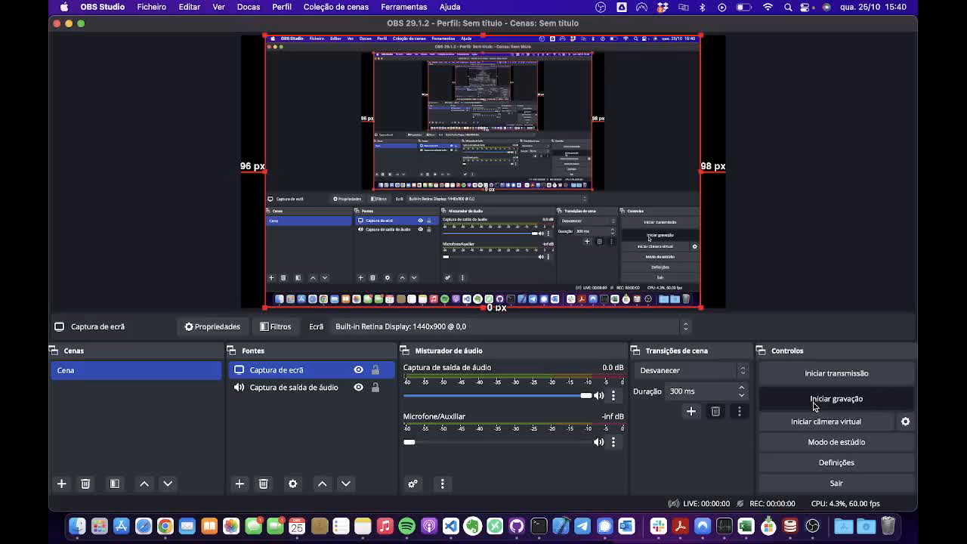
Dashboard

